Slide 1

StudyMate
By: Arman Miri

Slide 2

Why use StudyMate?
According to research done by Murray State University, students who create their own study guides tend to perform better on exams
87% of students who used self-generated guides performed better on exams

Slide 3
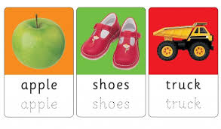
Flashcard Sets and Creation
Create flashcards manually or with the help of AI
Manual Creation
Provide the question and answer of the flashcard and add it to the set
AI Creation
Provide the content as text input or file upload and it will create a flashcard set for you based on the content provided

Slide 4

Study Guide Creation
Create study guides manually or with the help of AI
Manual Creation
Provide the content as you would in a normal document and it will create a PDF for you
AI Creation
Provide the content as text input or file upload and it will create a PDF study guide for you based on the content provided

Slide 5
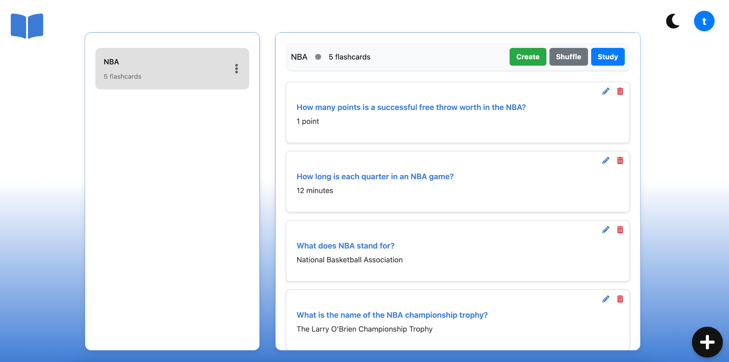

Slide 6
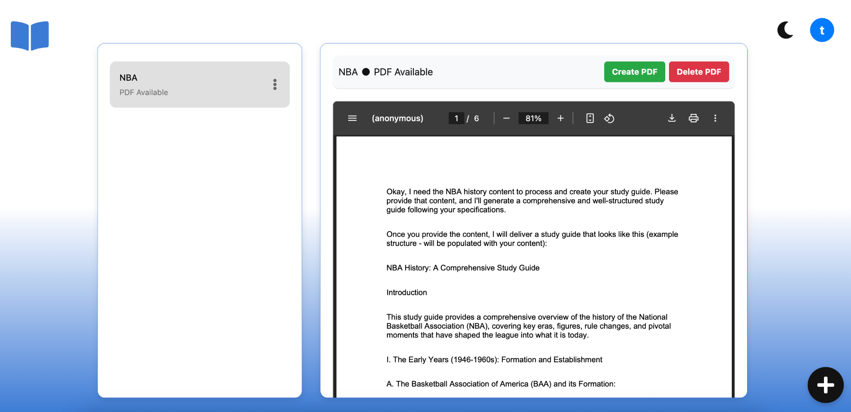

Slide 7
Demo

